Slide 1


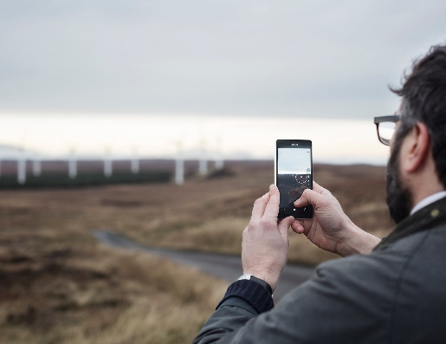




Build end-to-end IoT solutions Devices and Device Communication
Pamela Cortez
Azure IoT

Slide 2

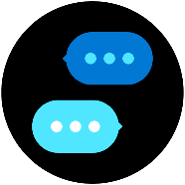



Build end-to-end IoT solutions – Workshop Series
https://aka.ms/IoT-online-workshop
Transform your business with IoT
Devices and device communication
Device provisioning at scale
Messaging processing, analytics, and business integration
Work with Azure IoT Edge
Notes:
In our first session, we’ll cover how Azure IoT is being adopted by enterprises and the problems that can be solved when you enable real-time digital feedback loops through the cloud. In the first labs, you’ll get started with the Azure portal, creating a dashboard and resource group. You’ll then explore the Azure services that will be used to provision and connect devices (IoT Hub and IoT Hub Device Provisioning Service)
Devices and device communication
In this session, we’ll take you through preparing a development environment you can use to build your IoT solution, both on the Azure cloud side and for your local work environment. For the labs, we’ll walk through evaluating a monitoring solution prior to full-scale implementation; you’ll connect a simulated IoT device that includes temperature and humidity sensors to IoT Hub; and you’ll verify that device telemetry is being received.
Device provisioning at scale
This portion of the workshop scenario walks through a hypothetical asset-monitoring solution that requires an IoT device with sensors for tracking location, temperature, and pressure included in product transport boxes. You’ll learn how you can use Azure Device Provisioning Service to enroll many devices automatically and securely.
Messaging processing, analytics, and business integration
You’ll write code to send continuous telemetry to an IoT Hub that will use Azure Stream Analytics and a built-in machine learning model to warn of anomalies. Power BI will be used to visualize the data stream, and you’ll create an event subscription within Azure IoT Hub to set up Event Grid integration that will trigger a logic app to send an alert.
Work with Azure IoT Edge
With large amounts of data being collected and urgent time responses needed, you’ll want to bring the intelligence to the edge for processing data and only send the important data to the cloud. Working through the exercises, you will setup an IoT Edge gateway; develop, deploy, and debug a custom module on Azure IoT Edge; and then run an IoT Edge device offline and in a restricted network.

Slide 3
Devices and Device Communication
Overview of IoT Hub Features
Developer Tools
Lab: Connecting Simulated Device
Install the VS Code extensions for developing Azure IoT solutions.
Configure a simulated IoT device (pre-built and written in C#) to connect to Azure IoT Hub.
Run the simulated device to send device-to-cloud telemetry messages to the Azure IoT Hub.
Verify that device telemetry is being received by Azure IoT Hub by using Azure CLI..
Developer Resources & Getting started

Slide 4
IoT fuels digital transformation
20B IoT Devices
20 billion connected devices by 2020
- Gartner -
50 GB per day
Devices
Smart
Home
People
Smart
City
1.5 GB per day
250 PB per day
1 million/ hour
new devices coming online
Vehicle
Smart
Autonomous
Factory
1 PB per day
5 TB per day
Smart
Smart
Stadium
- IDC -
180 zettabytes of digital data by 2025
Office
200 TB per game
150 GB per day

Slide 5
IoT enables a digital feedback loop
Customers
Operations
Deeper relationships
More efficient ops
1
Data: Capture digital signal across business
Customer signal
Operational data
Data + intelligence
2
Insight: Connect and synthesize data
3
Action: Improve business outcomes
Employee input
Mo
Product telemetry
Better products
Employees
re effective employees
Products

Slide 6

Microsoft invests $5 billion in IoT
Environment
Energy
RETAIL
Social
FINANCE
Economy
MANUFACTURING
Sustainability
EDUCATION
HEALTH
Store
Bank
Smart Spaces
MEDIA & COMMS
Logistics & Supply Chain Optimization
Grid Optimization
School
Stadium
Comms Network Optimization
Factory Optimization
Precision Farming
Hotel
Office
Home Energy Management
_{Traffic Flow Optimization}
Smart Campus
Supply Chain Optimization
Hospital
_{Connected Fleet}
EV Charging
Digital Signage
_{Connected Car}
Smart Rail
E-Bikes
Traffic Sensors & Cameras
Smart Streetlights
Municipal Command & Control Center
GOVERNMENT
AUTOMOTIVE
Urban Mobility
Our goal is to give every customer the ability to transform their businesses, and the world at large, with connected solutions

Slide 7


Microsoft IoT
Broadest portfolio
Industry Solutions
Manufacturing
Retail
Agriculture
Energy
Smart Cities
Healthcare
Transportation
Azure IoT Central
Dynamics Connected Field Service
IoT app services
Azure IoT Hub
Azure IoT Hub Device Provisioning Service
Azure Digital Twins
Azure Time Series Insights
Azure Maps
Azure Security Center for IoT
Azure Stream Analytics
Azure Cosmos DB
Azure AI
Azure Cognitive Services
Azure ML
Azure Logic Apps
Azure Active Directory
Azure Monitor
Azure DevOps
Power BI
Azure Data Share
Azure Spatial Anchors
Azure services for IoT
Azure RTOS
Azure Sphere
Azure IoT Device SDK
Azure IoT Edge
Azure Stack Edge
Windows IoT
Azure Certified for IoT—Device Catalog
Azure Stream Analytics
Azure Storage
Azure ML
Azure SQL
Azure Functions
Azure Cognitive Services
IoT & Edge Device Support

Slide 8
Azure IoT Hub
Bi-directional communication
Enterprise scale & integration
End-to-end security
Millions of Devices
Multi-language, open source SDKs
HTTPS/AMQP/MQTT
Send Telemetry
Receive Commands
Device Management
Device Twins
Queries & Jobs
Billions of messages
Scale up and down
Declarative Message Routes
File Upload
WebSockets & Multiplexing
Azure Monitor
Azure Resource Health
Configuration Management
Per Device Certificates
Per Device Enable/Disable
TLS Security
X.509 Support
IP Whitelisting/Blacklisting
Shared Access Polices
Firmware/Software Updates

Slide 9
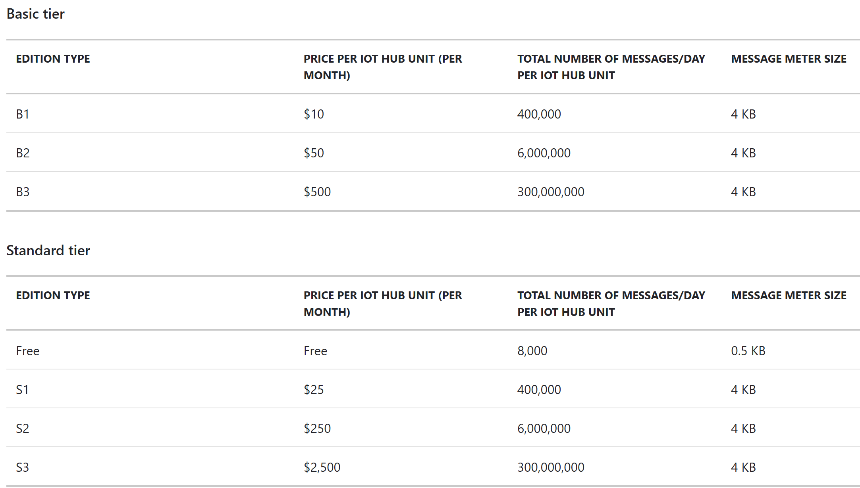
IoT Hub Offerings
Easy upgrade from basic to standard tier.
Only standard allows cloud-to-device commands, device twin operations and IoT Edge
Learn about IoT Hub scaling

Slide 10
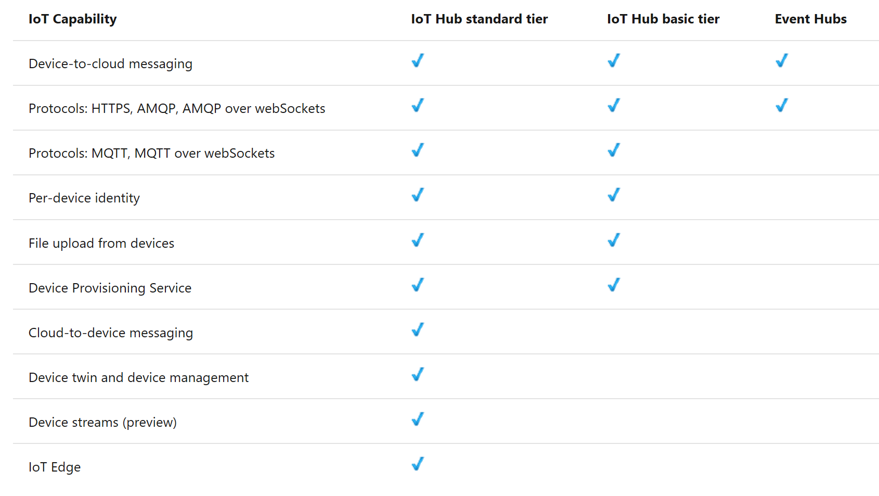
IoT Hub and Event Hub Comparison

Slide 11


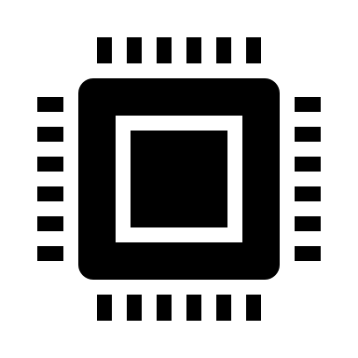

IoT Hub: Core Platform Capabilities
routes
storage blob
6
SB queues
Azure Cloud
Telemetry (D2C): async messaging from devices
C2D commands: async messaging to devices
Device/module twin: state document exchange
Direct methods: RPC (synchronous)
File upload: storage blob-based
Endpoints and routes
Device streams: streams-based, not message-based
event hubs
async msgs
async msgs
doc exchange
RPC
file based
stream-based
Telemetry
Commands
Twin
Direct methods
File upload
1
2
3
4
5
7
Device streams
IoT devices
Client SDK
Open Clients

Slide 12

Device Streams (Preview)
IoT Hub mediates device streams traffic
Scenarios
How to connect to devices inside private networks, or behind firewalls
Applications: RDP/SSH, access devices’ diagnostic portals
What?
A mechanism to establish secure TCP connections to/from devices in secure/private networks
Device streams are mediated by IoT Hub’s streaming endpoint
General-purpose and application/protocol agnostic
Device
stream
Azure IoT Hub
Secure/private network
Public network or a separate private network
Service endpoints
IoT Devices

Slide 13
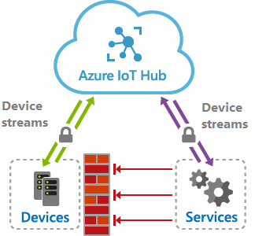
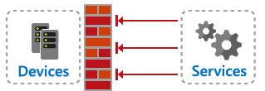
Device Streams Advantages
Firewall-friendly end-to-end connectivity
No need to open inbound ports on device or its network (only outbound port 443 is used)
Authentication enforcement
Both device and service authenticate using their IoT Hub credentials
Encryption enforcement
Traffic sent over device stream is always encrypted using TLS
Compatibility with TCP/IP stack
Ability to integrate into proprietary device applications or off-the-shelf TCP/IP applications including SSH/RDP, Web, File transfer, etc

Slide 14

Azure IoT Hub – Device Management
Used to orchestrate software/firmware/configuration changes
Enables customers to build custom support for any OS
Power plant
Azure
IoT Hub
Device twin
Device twin
Elevators
Desired
Desired
Reported
Reported
Smart meters
Tags
Methods
Methods
Medical devices
Query
Jobs
Buildings
Query across millions of device twins, schedule jobs to update them

Slide 15
Protocols
IoT Hub is inherently a message-based cloud-hosted service
Supported protocols are AMQP, MQTT and HTTP
Devices maintain a persisted connection to IoT Hub
Connections are all TLS-enabled and devices are authenticated
Devices have an IoT Hub identity (SAS key or a certificate)
We allow a special-purpose service-identity with higher privileges, e.g.,
Feature | Device-side protocols | Service-side protocols
D2C telemetry messaging | MQTT/WS + AMQP/WS + HTTP | AMQP/WS + HTTP
C2D messaging | MQTT/WS + AMQP/WS + HTTP | AMQP/WS
Direct methods | MQTT/WS + AMQP/WS | HTTP
Twin operations | MQTT/WS + AMQP/WS | HTTP
Device streams | MQTT/WS + AMQP/WS (C/C# only) | AMQP/WS (NodeJS/C# only)

Slide 16


IoT Hub Connectivity Models
All setups use IoT Hub’s core features
Direct over WAN
Protocol gateway
Edge
Devices have public IPv4 & connect to IoT hub directly
Direct from a private network
Devices have private IP
Devices’ traffic pass a net. gateway (e.g., HTTP GW) performing NAT
Devices connect to PG
A special-purpose protocol gateway
Edge runtime deploys & manages devices’ code
PG connects to IoT Hub on behalf of devices with their identity
e.g., connected car
e.g., robots in factory floor
e.g., city street lights
Device talks our supported protocols
Indirect through a field gateway
Devices don’t know any of our supported protocols
Devices connect to a field gateway that supports our protocols
e.g., soil moisture sensors on a farm
e.g., deploy image detection for boxes on a conveyor belt
Usually involves high-powered devices
IoT Hub
IoT Hub
IoT Hub
IoT Hub
IoT Hub
BLE/NFC
Edge device
Factory
Edge
FG
GW
PG
Batching &
Proto translation
On-prem
network
Protocol
translation
AI
AI
WAN

Slide 17
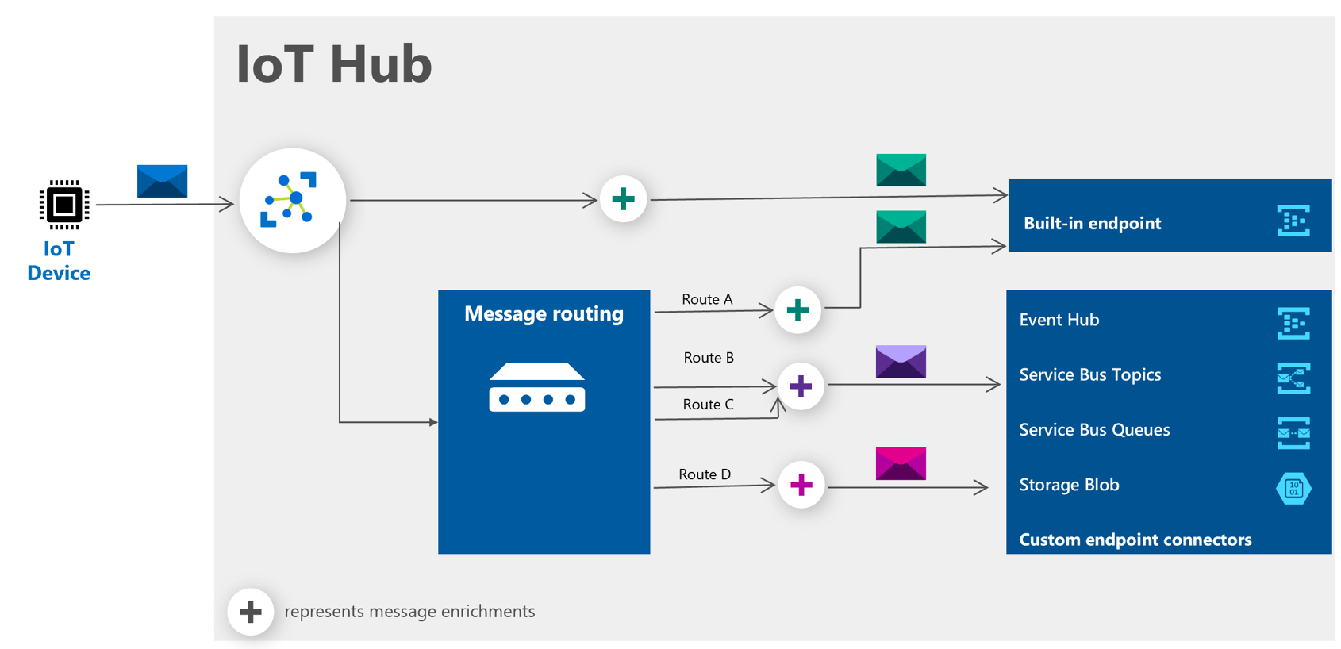
IoT Hub Message Enrichments
Learn more about Message Enrichments
Enrichment Values supported
Device Twin tags, properties
IoT Hub name
Static string
Notes:
Message enrichments describes the ability of Azure IoT Hub to stamp messages with additional information before the messages are sent to the designated endpoint.

Slide 18
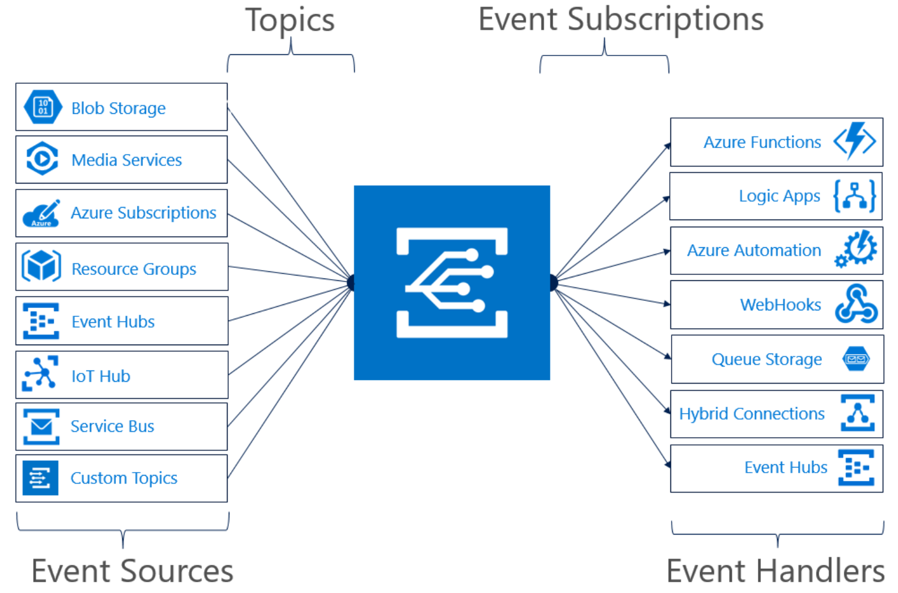
Serverless Integration
Events supported:
Device Telemetry
Device Created/Deleted Events
Device Connected/Disconnected Events
Learn more about Event Grid
Notes:
Azure IoT Hub integrates with Azure Event Grid so that you can send event notifications to other services and trigger downstream processes.
For example: If I wanted to create an alert to send an email whenever a new device is created, I could create a Logic App and IoT Hub event subscriptions
Filter events
IoT Hub event subscriptions can filter events based on event type, data content and subject, which is the device name.

Slide 19
Device Twin
Twin
Bi-directional device<->hub communication channel
Based on per-device (per module) json documents
Used to store configuration and control-plane state
Supports queries
Twin sections
Tags: set by service and not viewable by device
Desired properties: set by service and delivered to device
Reported properties: set by devices and delivered to service
Report data
Query data
Device
IoT Hub
IoT App (service)
Device
IoT Hub
Service
3. Set desired
properties
1. Register
for twin
change
notifications
2. Read/listen for
twin changes
4. Update
twin
5. Read desired prop changes
6. Update reported properties
EH, SB, blobs
7. Update
twin
8. Receive
twin change

Slide 20
Devices and Device Communication
Overview of IoT Hub Features
Developer Tools
Lab: Connecting Simulated Device
Install the VS Code extensions for developing Azure IoT solutions.
Configure a simulated IoT device (pre-built and written in C#) to connect to Azure IoT Hub.
Run the simulated device to send device-to-cloud telemetry messages to the Azure IoT Hub.
Verify that device telemetry is being received by Azure IoT Hub by using Azure CLI..
Developer Resources & Getting started
Notes:
What is IoT Hub?
Architecture, protocols and connectivity models
Introducing BikeCity: a real-world usage scenario
Core messaging features
Monitoring and logging

Slide 21



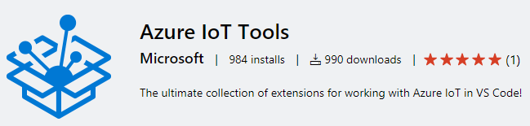
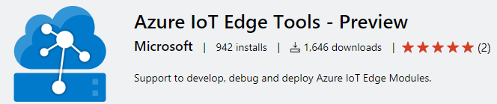


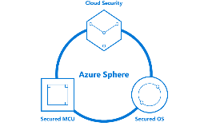
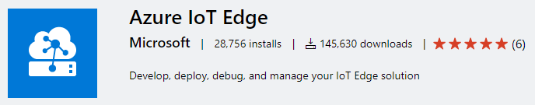


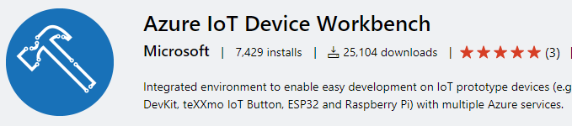

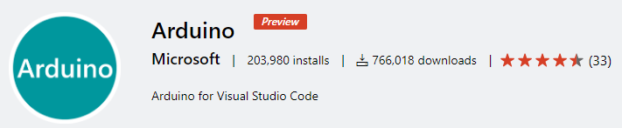
Azure IoT Tooling support
Visual Studio
Visual Studio Code
IoT DevOps
Azure IoT Hub support in Cloud Explorer
IoT Edge tasks for Azure Pipelines
IoT Edge Jenkins plugin
Azure DevOps project for IoT Edge
Azure Sphere Tools for VS
Azure IoT CLI Extension
iotedgedev CLI Tool
iotz
Notes:
Distributed Tracing for IoT Hub

Slide 22
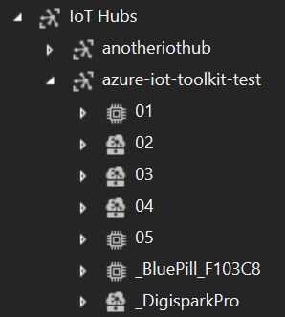
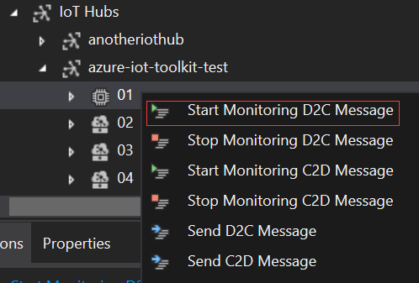

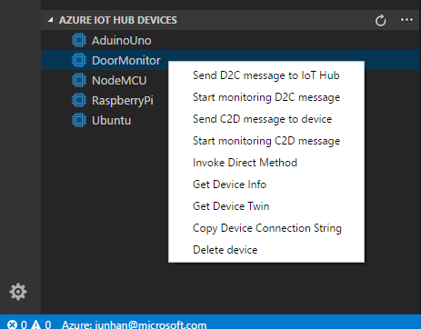
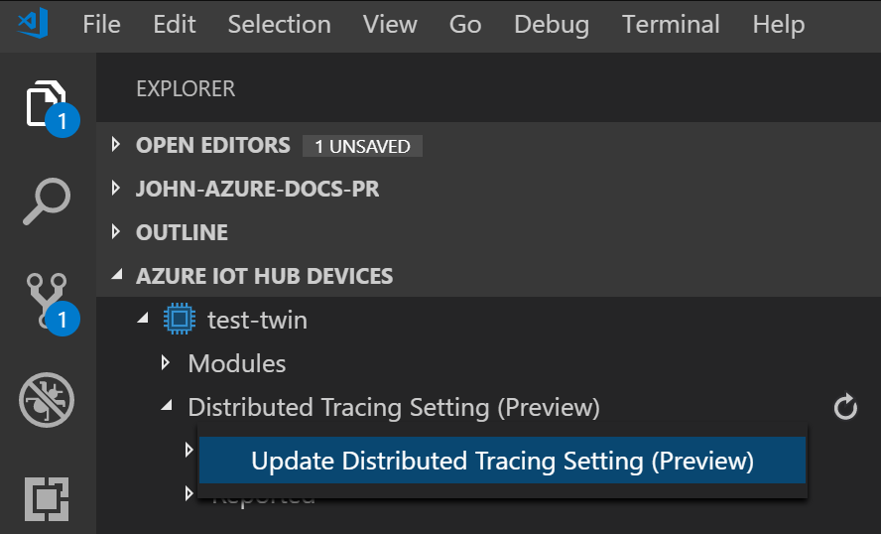
Azure IoT Hub tools
Cloud Explorer for VS 2017/2019
VS Code IoT Hub Toolkit
Azure IoT CLI Extension
https://github.com/Azure/azure-iot-cli-extension.

Slide 23
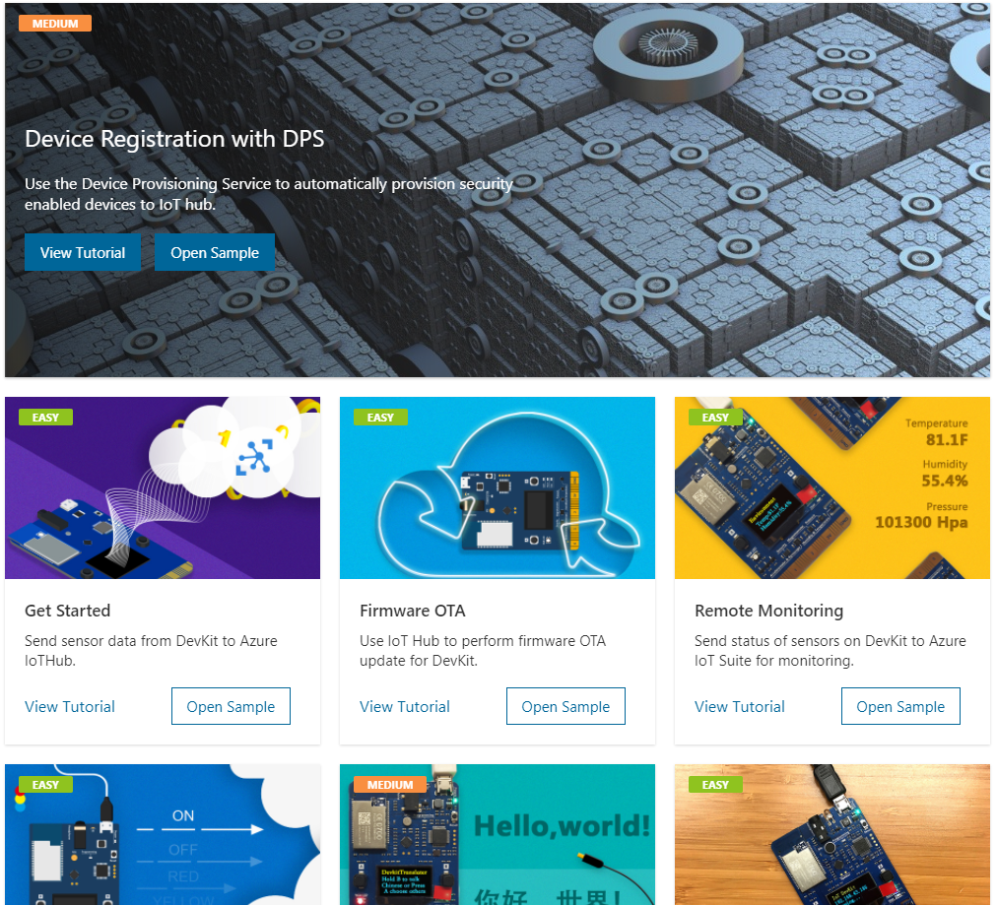
Azure IoT Device Workbench for VS Code
Support Certified Azure loT Devices
Start from Solution Gallery or custom IoT project
Code, build, deploy and debug

Slide 24
Devices and Device Communication
Overview of IoT Hub Features
Developer Tools
Lab: Connecting Simulated Device
Install the VS Code extensions for developing Azure IoT solutions.
Configure a simulated IoT device (pre-built and written in C#) to connect to Azure IoT Hub.
Run the simulated device to send device-to-cloud telemetry messages to the Azure IoT Hub.
Verify that device telemetry is being received by Azure IoT Hub by using Azure CLI..
Developer Resources & Getting started
Notes:
Install the .NET Core 3 SDK, Azure CLI, and the Visual Studio Code (VSCode) editor. (.NET Core 3.1.200 (or later) SDK)
Install the VSCode extensions for developing Azure IoT solutions.
Configure a simulated IoT device (pre-built and written in C#) to connect to Azure IoT Hub.
Run the simulated device to send device-to-cloud telemetry messages to the Azure IoT Hub.
Verify that device telemetry is being received by Azure IoT Hub by using Azure CLI.

Slide 25
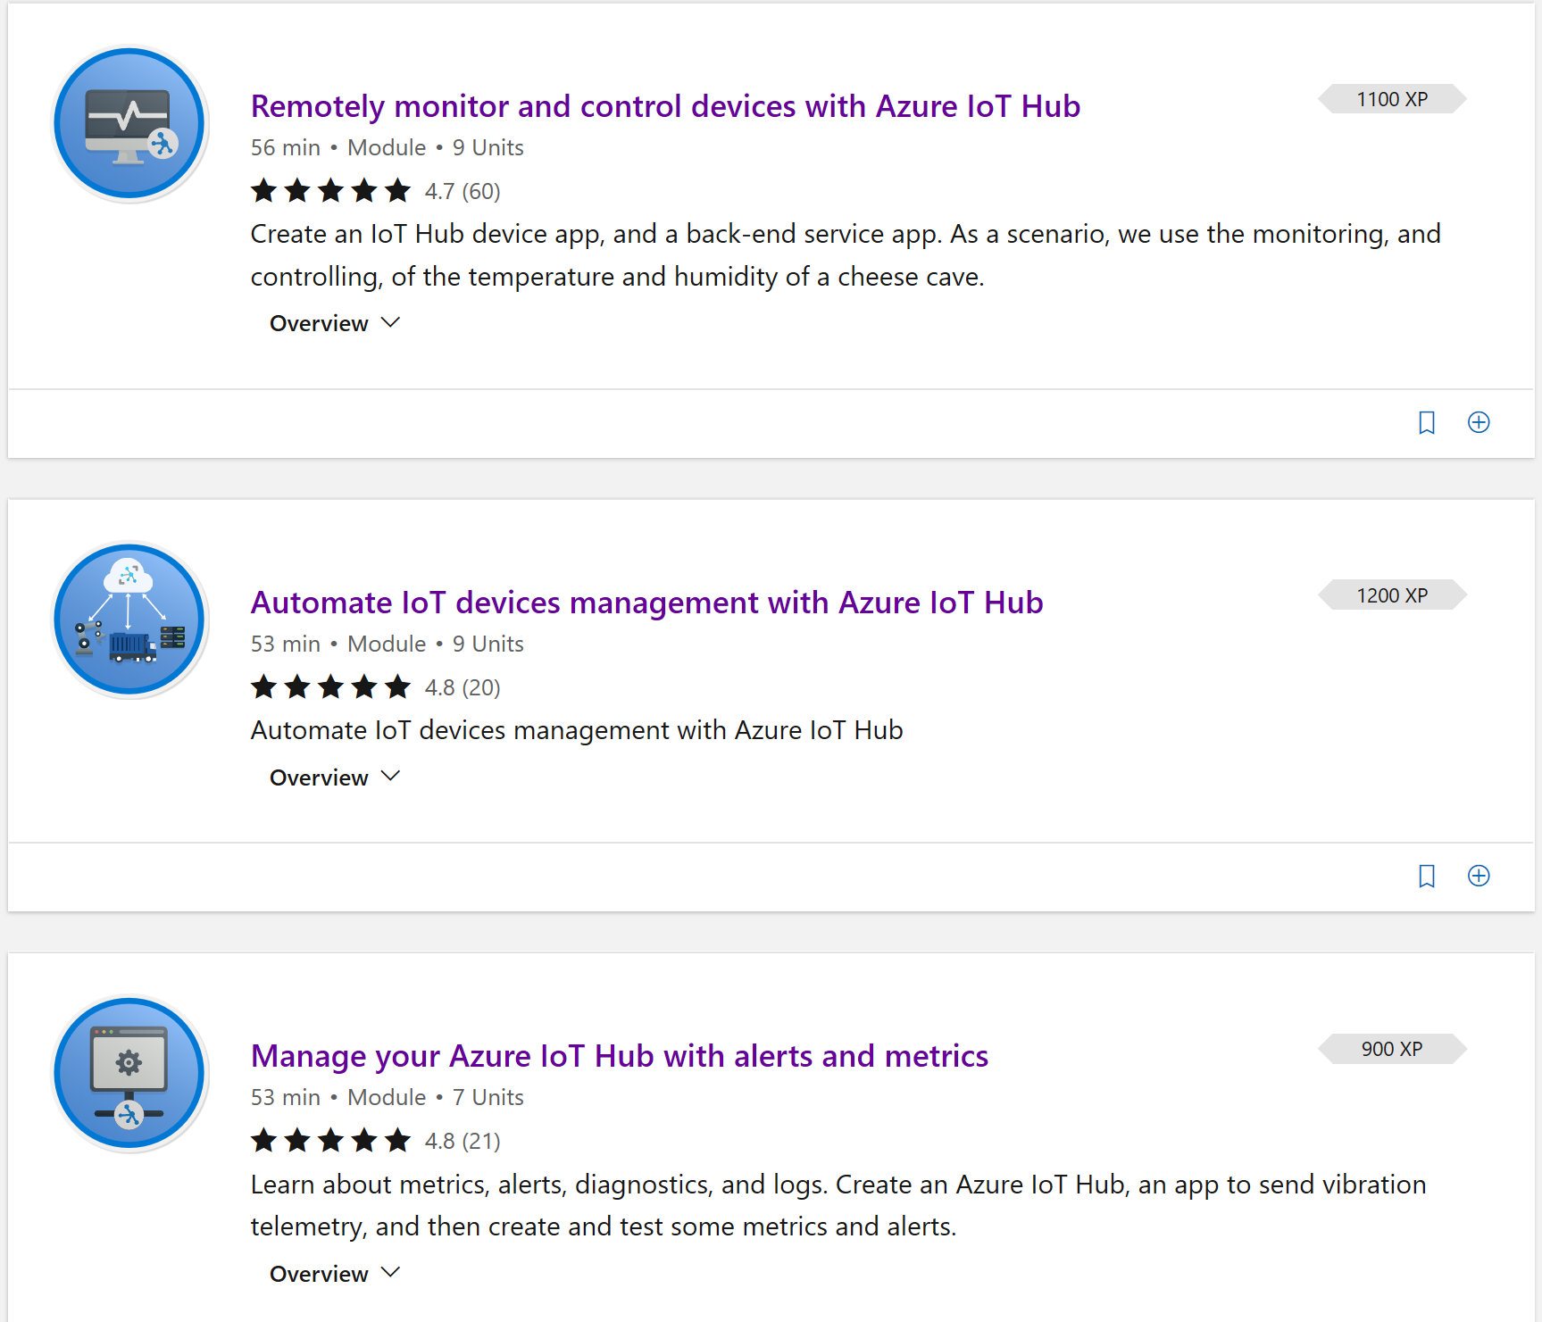


Get Started Now!
https://aka.ms/SecurelyConnectDevicesLearningPath
https://aka.ms/IntroAzureIoTLearningPath
Sign-up for Build end-to-end IoT solutions – Workshop Series
https://aka.ms/IoT-online-workshop
Transform your business with IoT
Devices and device communication – IoT Hub
Device provisioning at scale – Device Provisioning Service
Messaging processing, analytics, & business integration – Time Series Insights, Event Grid, Azure Stream Analytics
Work with Azure IoT Edge – IoT Edge

Slide 26
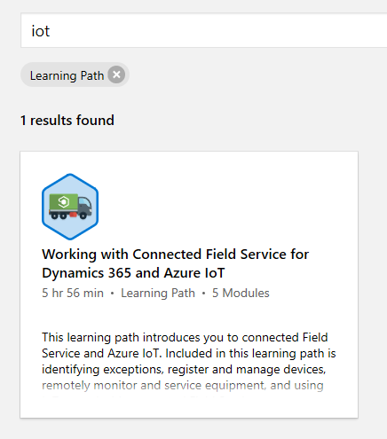
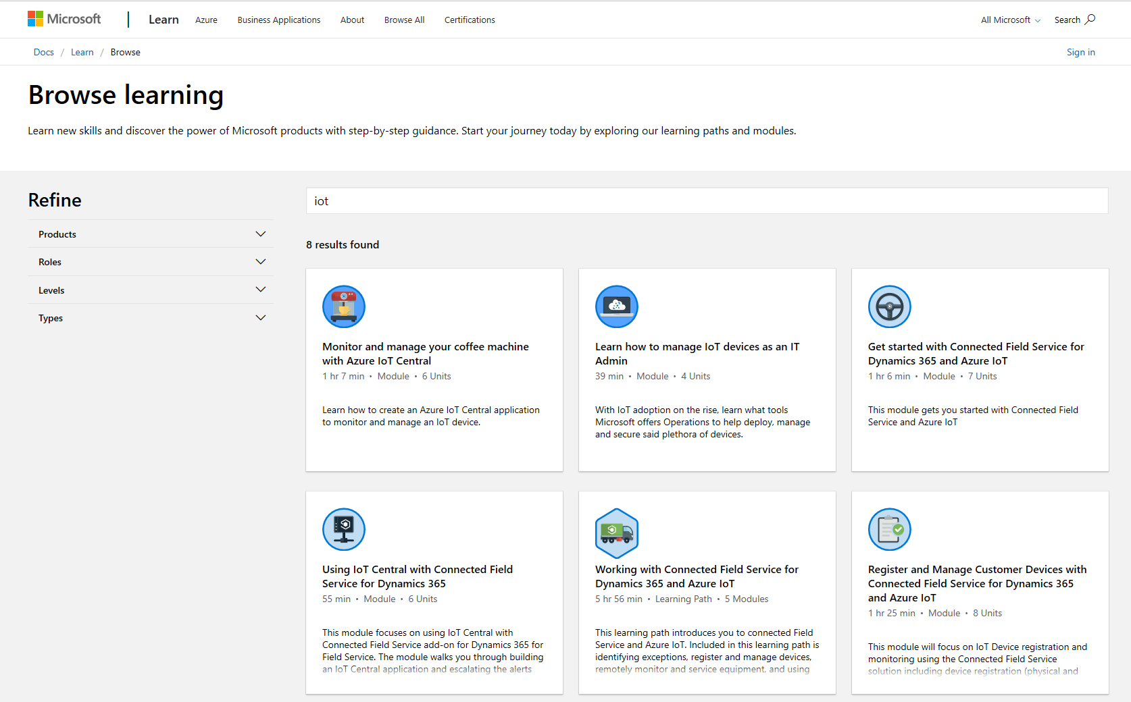
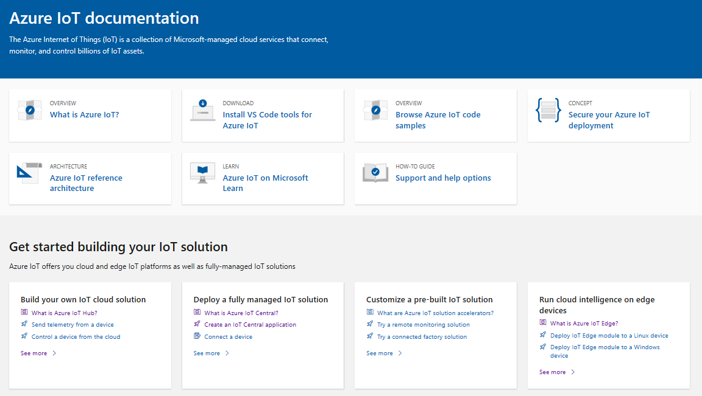
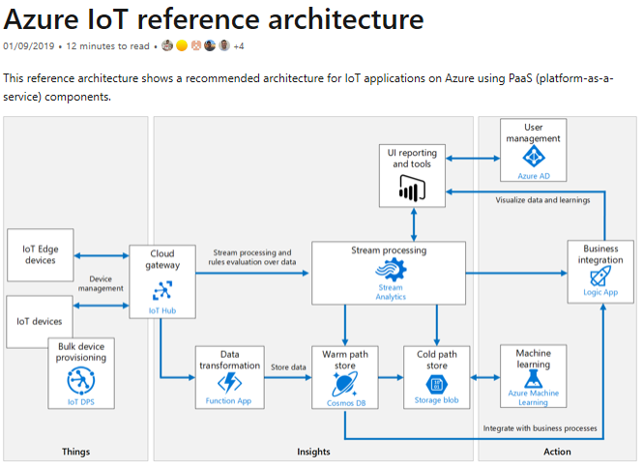
Learn how to get started with IoT
Building IoT solutions with Azure Developer Guide https://discover.microsoft.com/azure-iot-building-solutions-dev-guide/
Microsoft Learn learning paths
http://aka.ms/mslearniot
Microsoft Learn is a newer learning platform that offers sandbox online training
Azure IoT Reference Architecture Guide https://docs.microsoft.com/azure/architecture/reference-architectures/iot/
This reference architecture shows a recommended architecture for IoT applications on Azure using PaaS (platform-as-a-service) components.
Azure IoT Docs
Getting Started, Tutorials, How-to guides, reference, whitepapers
Notes:
PC

Slide 27
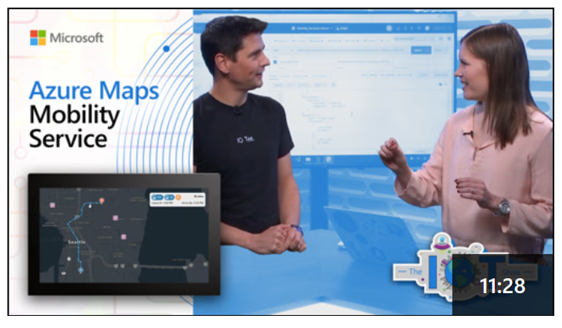
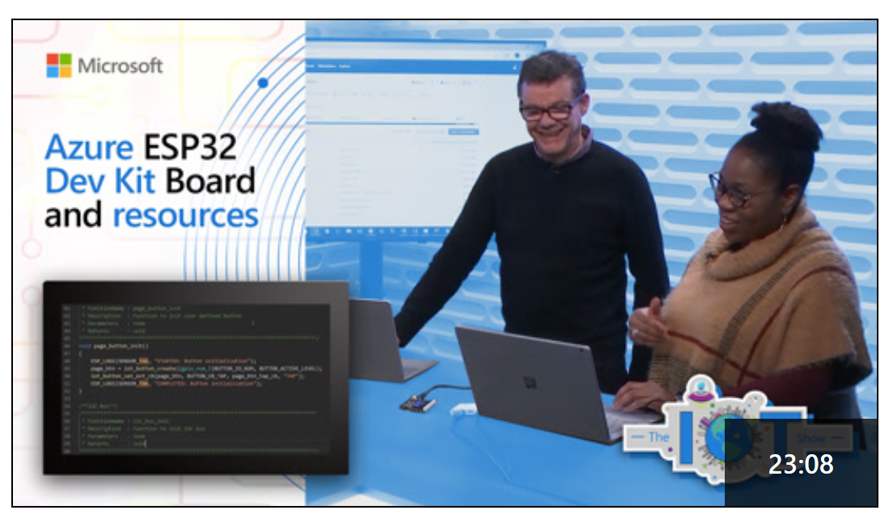
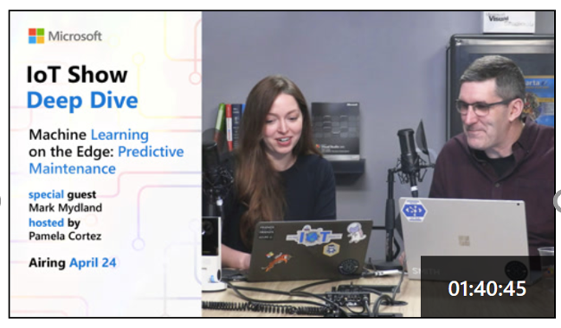
IoT Show
New video every Monday (Deep Dives on Wednesdays!) Subscribe to stay up-to-date with latest Microsoft IoT announcements, product and features demos, customer and partner spotlights, top industry talks, and technical deep dives with IoT Show! aka.ms/IoTShow

Slide 28
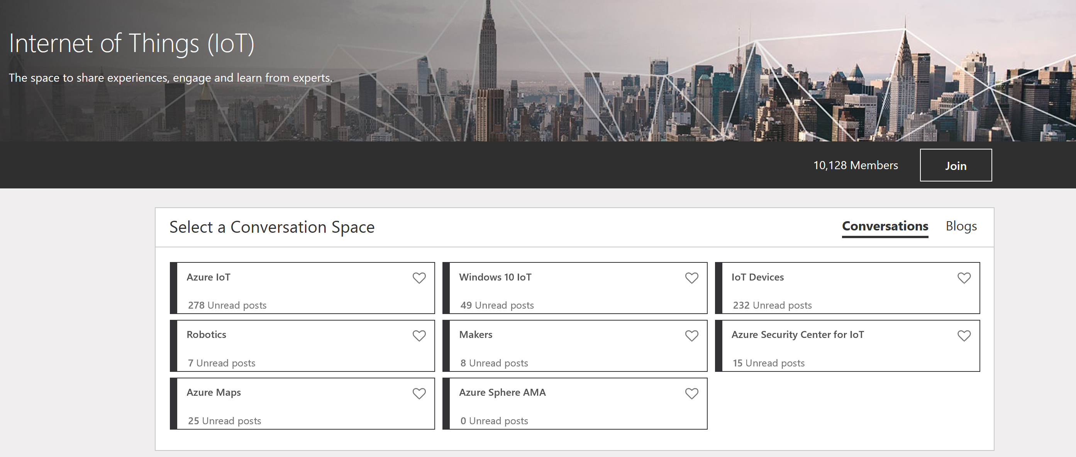
IoT Tech Community
Community forum to stay to update on latest announcements, connect with other developers, share your projects, and ask questions!
Fast growing vibrant community
One Microsoft IoT voice
http://aka.ms/iottechcommunity

Slide 29
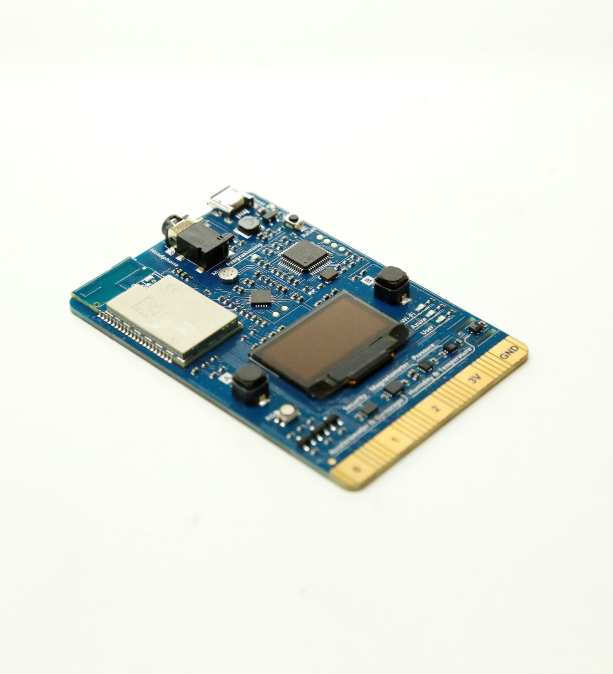
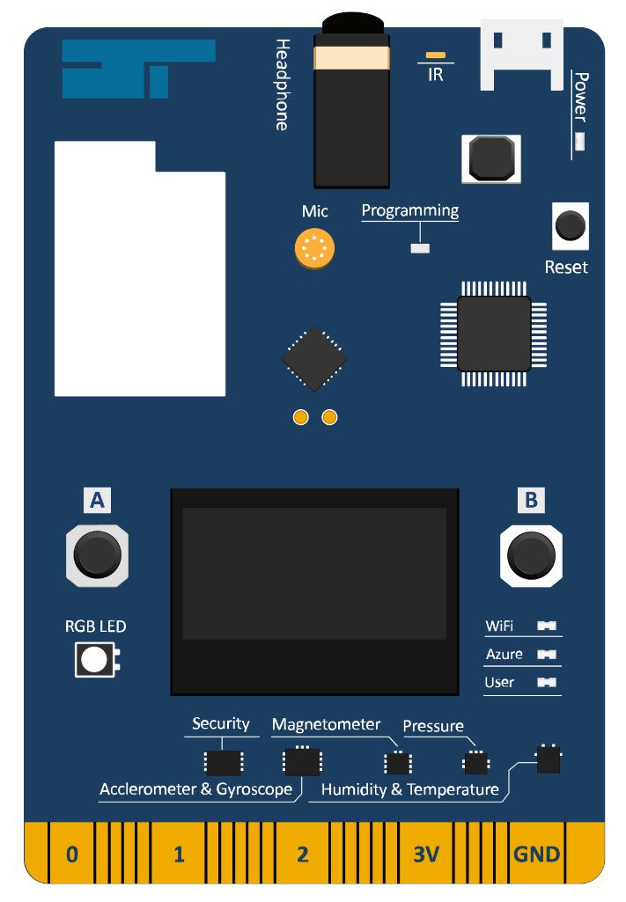
Azure IoT DevKit
All-in-One kit built for Cloud
Microphone
Headphone Jack
IrDA
MCU
STM32F412
Micro-USB
Power LED
Wi-Fi
BCM43362
3.3V DC-DC
Reset Button
Audio Codec Chip
Programming LED
OLED
DAP Link Chip
STMF103
Button A
Button B
Wi-Fi LED
RGB LED
Azure LED
User LED
Security Chip
ST-SAFE A100
Edge Connector

